Slide 1
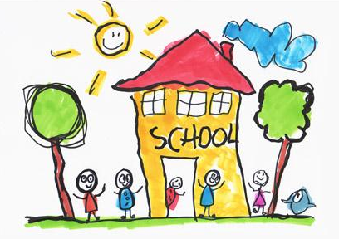

Welcome to Oakthorpe Primary School. We look forward to working with you!
Our guide to the Early Years Foundation Stage and your child’s first year at Oakthorpe Primary School.

Slide 2

www.ovallearningtrust.org
Albert Village Primary
Viscounts Beaumont C of E Primary
Swannington Primary
Blackfordby Primary

Slide 3
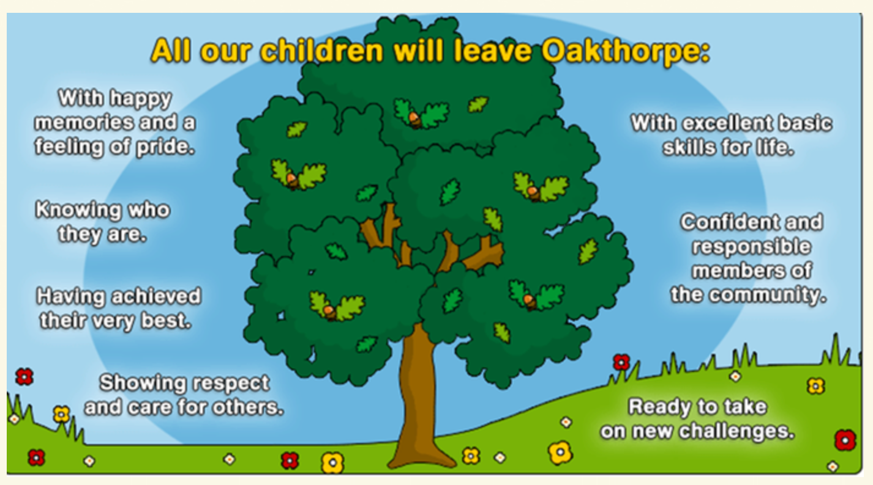
A welcome from the Head teacher…

Slide 4
Office and communications Mrs Goodwin
Packs of forms to complete
Free school meals and universal infant school meals
Parent Money
Calling the office
Medicines – must complete a form
E-newsletters and text alerts (along with twitter) are main forms of communication.
Policies are on website

Slide 5
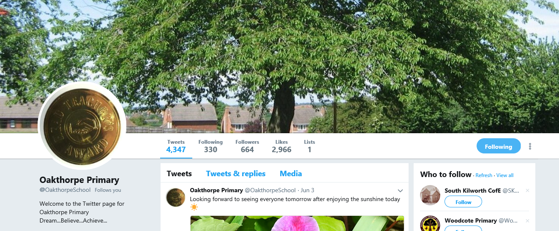
School facebook @oakthorpeschool
School twitter @oakthorpesch
School Website www.oakthorpeprimary.co.uk

Slide 6
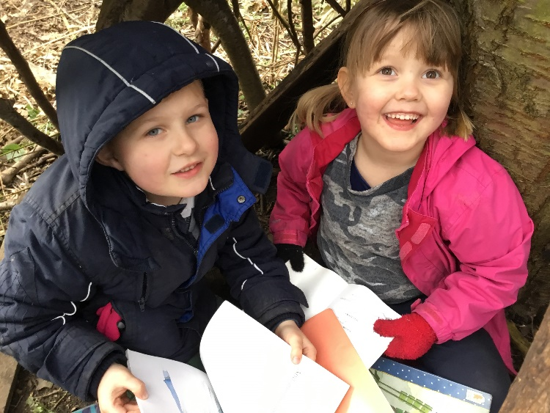
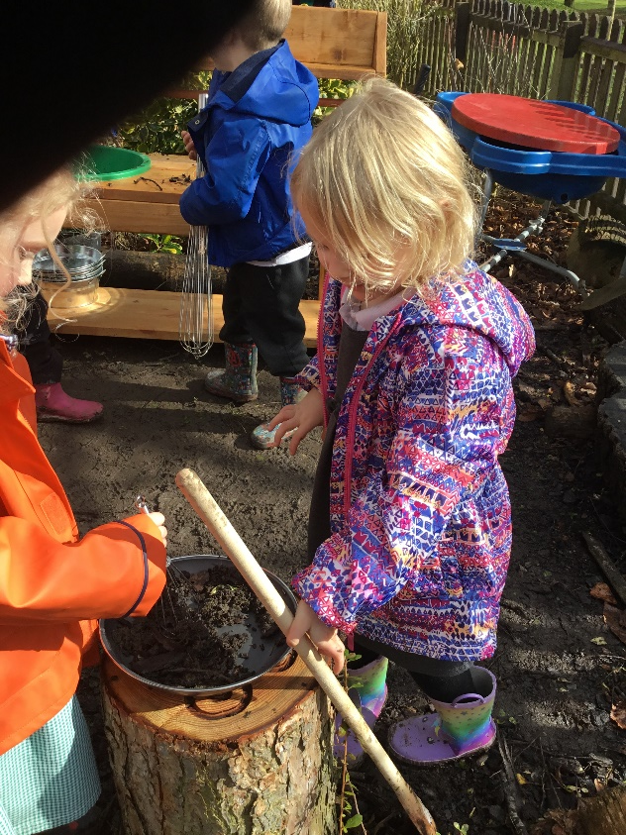
Expectations and routines
Forest schools is a lot of fun.
Children need to at school on time after a good nights sleep!
Arrival – 8.35am whistle just before 8.45am (at side of school)
Departure – 3.00pm (EYFS outdoor area gates)
Attendance is really important – aim is to stay above 96%.
Uniform – black shoes, grey or black trousers or skirts, black shorts / white or black tops, joggers for PE and white PE top or with logo, plimsoles(from Babes to Tots in Ashby). Wellies and overalls for outdoor learning.
Exploring mixtures and messes in the mud kitchen.

Slide 7
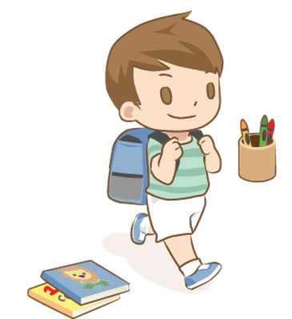
Starting School…
Your class teacher is: Miss Cree
There will also be a full time teaching assistant in Reception.
We want to make the transition into starting school as smooth as possible for children and Parents/ Carers.
If you ever have any queries or concerns, Miss Cree is outside of school at the beginning and at the end of the day.
If there is anything you feel we can do to help you with getting your child ‘school ready’ please don’t hesitate to ask.
Don’t forget to sign up to a home visit where we will chat further.
Notes:
Cheryl

Slide 8
Transition Dates- to follow

Slide 9

The First Day of School
Arrival at school is 8.35am. Whistle goes at 8.45am.
The school day ends at 3pm. Collect your child at the Early Years Outdoor area gates.
Children need to come to school prepared for each day- this includes full uniform, with PE kit which will stay in school for half a term and a book bag on a daily basis.
Please ensure ALL of your child’s belongings are named!
It really does help if children can develop independence from day one.
Notes:
Cheryl

Slide 10
Food and Drink
Fruit (free for all KS1 pupils daily) and milk. (Free CoolMilk until 5 years old, which can be paid for thereafter.)
Lunchtime arrangements (Universal free school meals upto KS1)
Water bottles in the classroom.
Notes:
Cheryl

Slide 11

Being School Ready-
These are some expectations of a 4 year old.
I can get dressed/undressed by myself.
I can take off and put on my shoes.
I can put my coat on and fasten it.
I can ask to go to the toilet.
I can independently clean myself after visiting the toilet and wash my hands.
I can sit and listen to a story.
I can share and take turns.
I can listen when someone else is talking.
I can ask for help if I need it.
I can use a knife and fork.
Notes:
Rosie

Slide 12
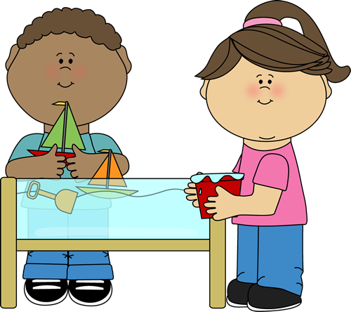
The Early Years Profile: 17 areas in all…..
Children will be learning skills, acquiring new knowledge and demonstrating their understanding through 7 areas of learning. All are vital and inter-connected.
The 3 Prime Areas
      Personal, Social and Emotional development.
      Communication and Language.
      Physical Development
The 4 Specific Areas
      Literacy
      Maths
      Understanding the World
      Expressive arts and design
      The 7 areas are broken down into 17 headings…..

Slide 13
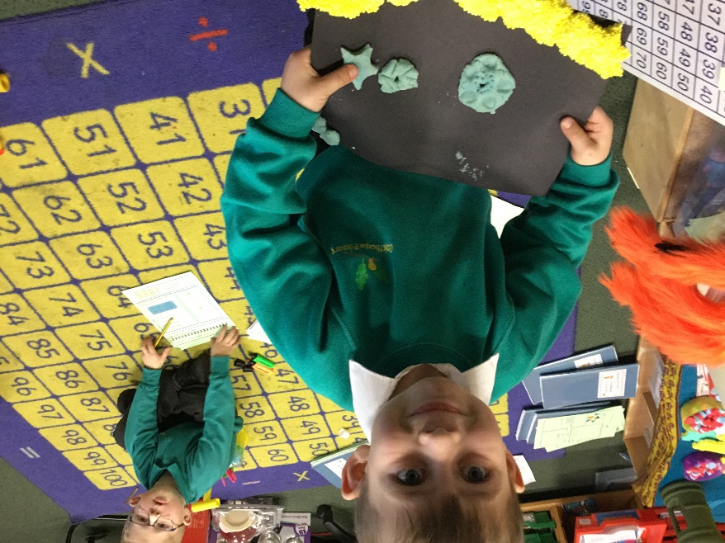
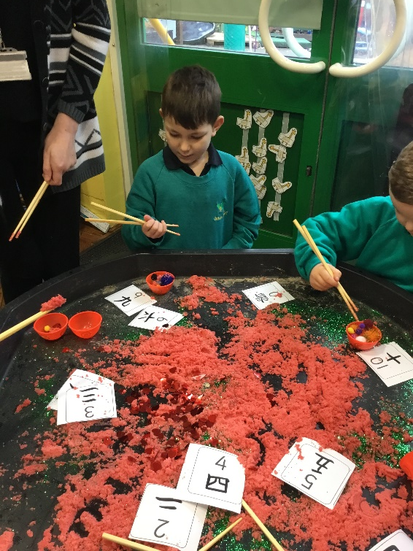
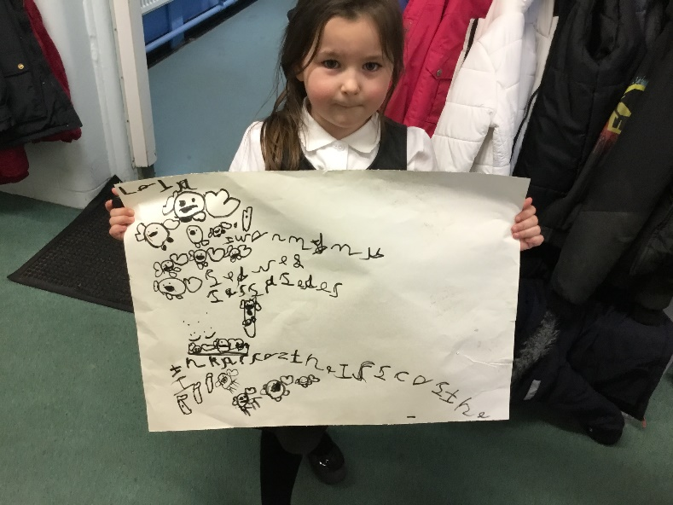
So….. how do we do it?
Balance - between adult led and child initiated learning
Using assessment
Modelling and scaffolding
Adult led carpet sessions
Harry’s Van Gogh artwork using playdough and play foam.
Learning to use chopsticks for Chinese New Year.
A story map of Owl Babies.

Slide 14
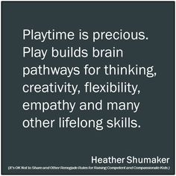
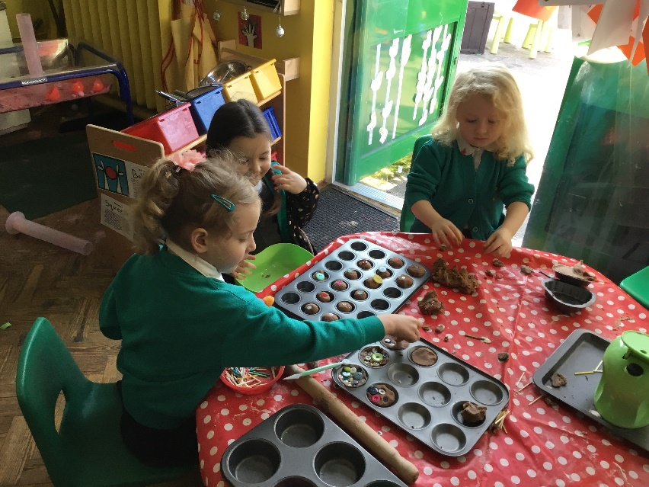
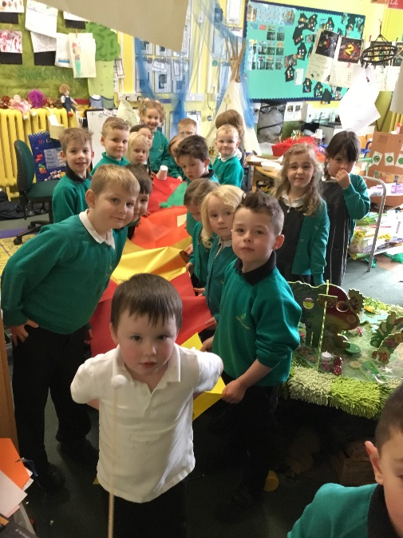
Purposeful Play
Each of the 17 areas are implemented through planned, purposeful play and through a mix of adult led and child-initiated activity.
We also listen to children’s interests and tailor their learning to their particular needs and passions.
Our whole class Chinese New Year Dragon to dance with.
Learning to count on from ten using the play dough.

Slide 15
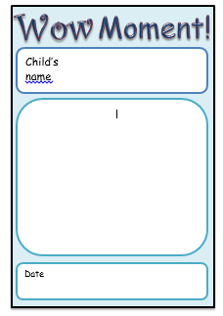
Learning Journeys
Children will be assessed within the 17 areas, based on their individual development and needs throughout the Reception year. We will track their development within a learning journey- collecting evidence for judgments with videos, photos, written observations, post it note comments as well focusing on what the children can do independently and within adult led activities.
‘WOW’ moments
We will send ‘Wow’ moments home every term to be filled in when your child does something amazing at home. If they have learnt to ride a bike, worked hard on some writing, learnt to swim- anything that has made you ‘wow’ we would love to know. If you need any more sheets please let us know.

Slide 16

Reading
The best way to support your children at home will be to read with them everyday and comment in the home learning diary about how they are getting on. Children will also be given a set of tricky and/or high frequency words to learn. Children will be given a set reading day however please keep their reading books and reading record in their book bag each day.
Children are also given home learning each Friday to be completed by the following Wednesday. Each week there are a range of ways to support your child with what we have been learning that week of school.

Slide 17
Parental Partnership
Parents are invited into our ‘sharing assemblies’ and open sessions throughout the year.
You will be given regular feedback about your child’s progress and have a daily opportunity to discuss matters with the staff.
Curriculum Letters and Newsletters
Parent Evenings and Annual Report.
.
Home/school collaboration is paramount!

Slide 18

Thank you for coming today.
We look forward to working with you.
Please ensure you sign up to a home visit.
Notes:
Cheryl

